Slide 1
Interfacing of Vibrator sensor using Beaglebone black
JASMEET SINGH(CO751797)
GROUP #2

Slide 2
CONTENT
PROJECT OVERVIEW
REQUIREMENTS FOR INTERFACING
Hardware Requirements
Software Requirements
COMMUNICATION PROTOCOL USED FOR INTERFACING
INTRODUCTION TO BEAGLEBONE
Pin Layout
Features
INTRODUCTION TO VIBRATION SENSOR
Features of Vibration sensor
Function
INTERFACING OF VIBRATION SENSOR
Schematic layout
Connections of vibration sensor and beaglebone black
Libraries used for interfacing
Coding
TERMINAL OUTPUT
REFERENCES

Slide 3
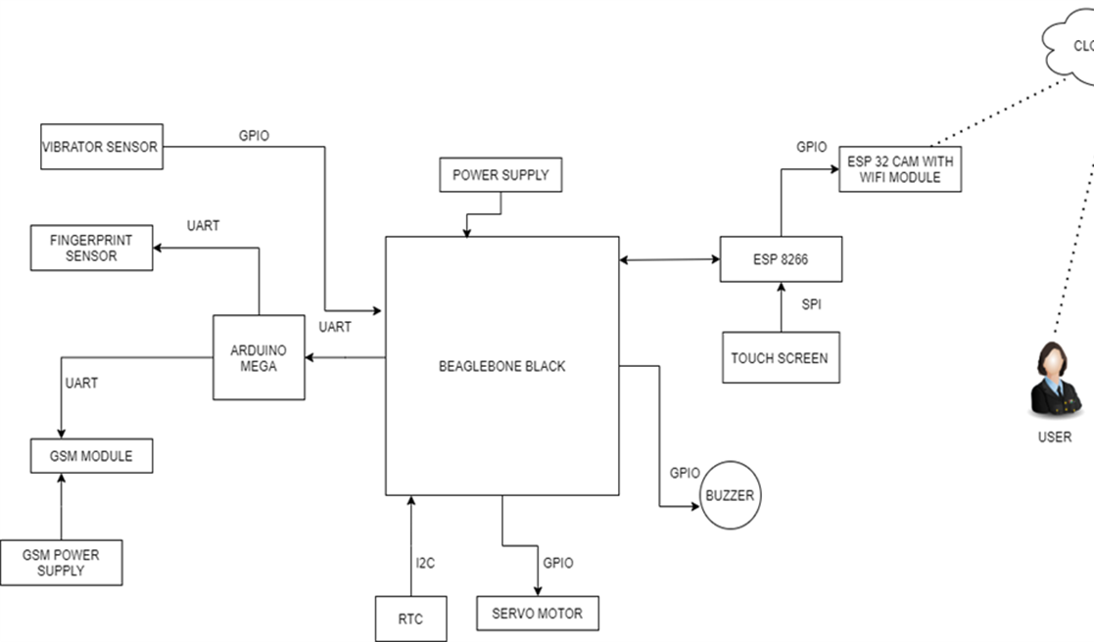
PROJECT OVERVIEW

Slide 4
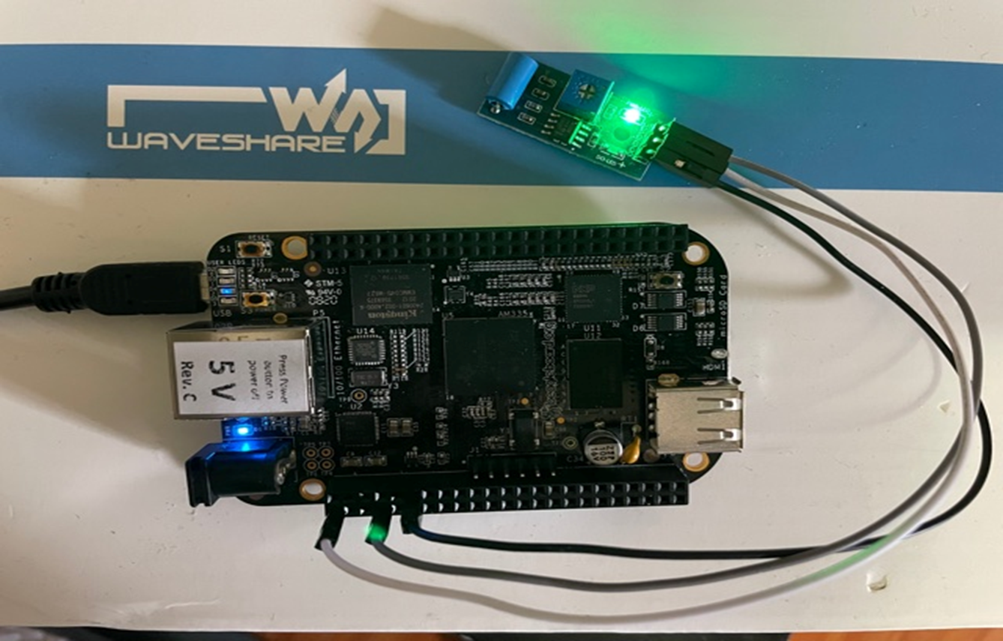
PROJECT OVERVIEW
The main objective of this project is to effectively control and manage the bank locker security using fingerprint sensor, passcode and camera.
The IOT based Bank locker security system uses an automated Safety vault with layered defense mechanism.

Slide 5
REQUIREMENTS
For the completion of this project, after interfacing of buzzer, fingerprint sensor and servo motor, the next task is interfacing of vibrator sensor with beaglebone black.
For interfacing, there are some hardware and software requirements.

Slide 6
HARDWARE REQUIREMENTS
Beaglebone black
Vibration Sensor
Jumper wires
USB Cable

Slide 7
SOFTWARE REQUIREMENTS
Terminal
GCC compiler
GNU Nano editor

Slide 8
COMMUNICATION PROTOCOL USED FOR INTERFACING
For vibaration sensor interfacing, the digital pins of beaglebone black are used.
It is connected to the beaglebone black using its GPIOs.

Slide 9
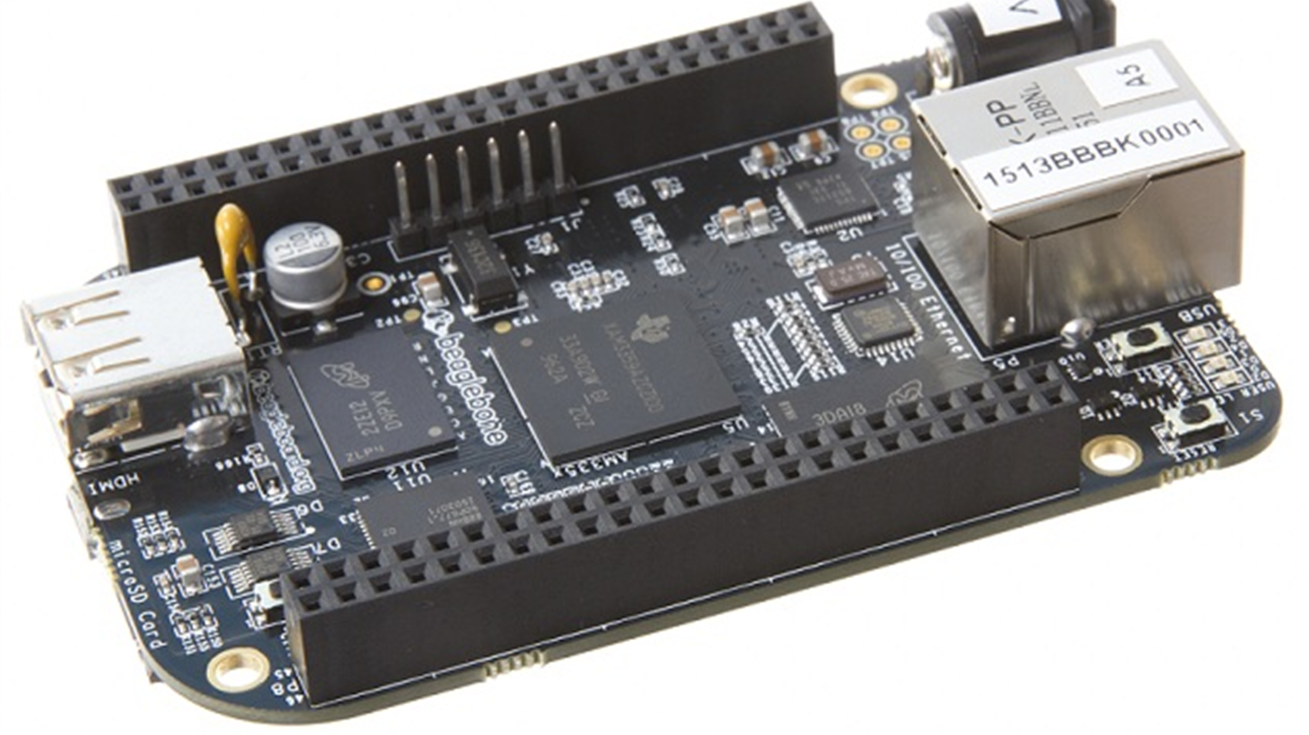
ROLE OF BEAGLEBONE BLACK
Beaglebone Black is our main microcontroller unit as all the components are connected directly
It is a low-cost, community-supported development platform.
All the components are connected directly or indirectly to the beaglebone as its the main microcontroller unit.

Slide 10
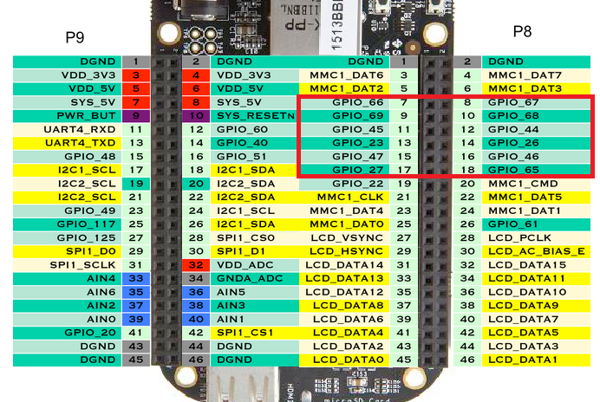
PIN LAYOUT OF BEAGLEBONEBLACK
Pins used for interfacing

Slide 11
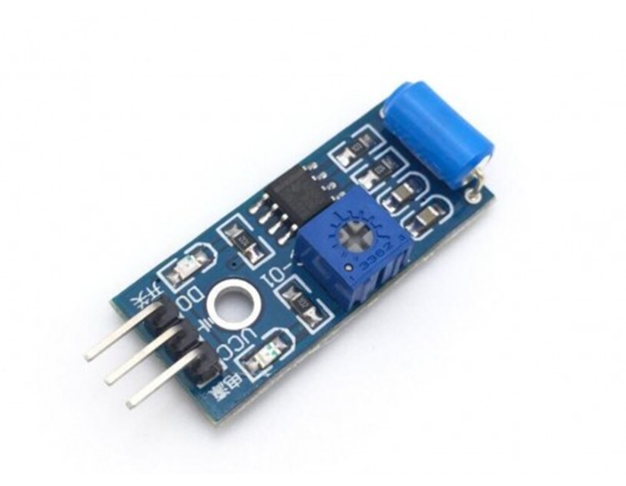
INTRODUCTION OF VIBRATOR SENSOR
The Vibration sensor is used to detect if there is any vibration that is beyond the threshold. The threshold can be adjusted by the on-board potentiometer. When there no vibration, this module output logic LOW the signal indicate LED light, and vice versa.

Slide 12
FEATURES OF VIBRATOR SENSOR
The default state of the switch is close.
Digital output Supply voltage:3.3V-5V
On-board indicator LED to show the results.
Dimension of the board: 3.2cm x 1.4cm

Slide 13
FUNCTION OF VIBARATOR SENSOR
It is used in our project to detect vibration as when somebody will try to open the bank locker forcefully, this sensor will start vibrating.

Slide 14
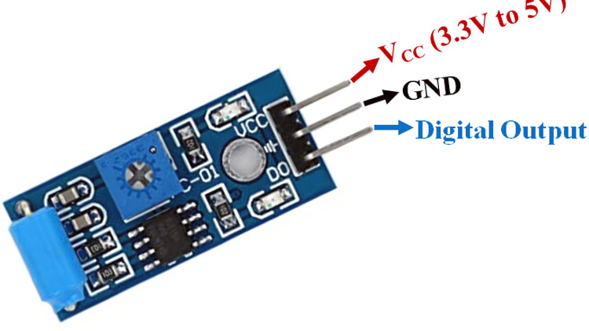
PIN LAYOUT OF VIBRATOR SENSOR

Slide 15
INTERFACING OF VIBARATOR SENSOR AND BEAGLEBONE BLACK
VIBRATOR SENSOR | BEAGLEBONE BLACK
D0 | P9.12
VCC | VCC
GND | GND
Vibration sensor is connected directly to the beaglebone black with the help of GPIO pins.
This sensor is used to detect any unauthorized access by hammering the locker.

Slide 16
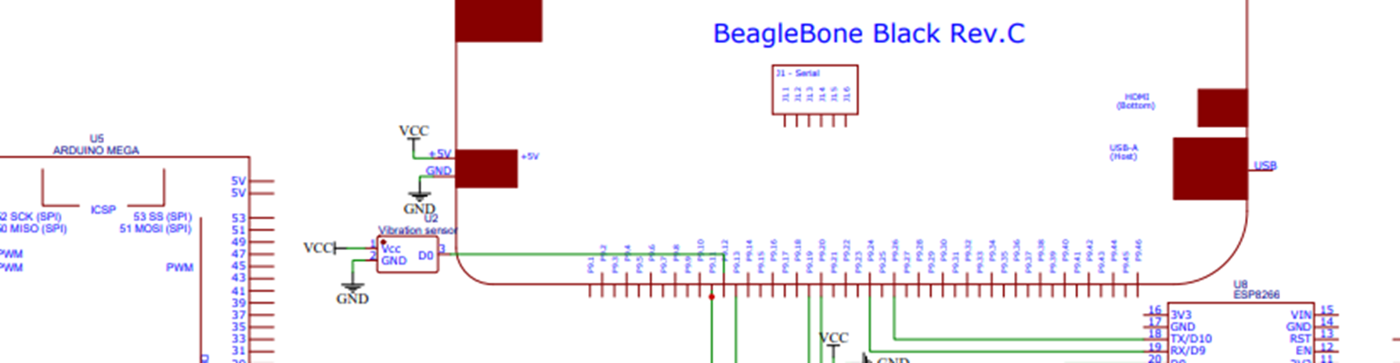
SCHEMATIC DIAGRAM

Slide 17

CONNECTION OF VIBARATOR SENSOR AND BEAGLEBONE BLACK

Slide 18
LIBRARIES USED IN INTERFACING
IOBB LIBRARY:
As the vibration Sensor is directly connected to GPIO pins of beagleboneblack we need IOBB library.
We already installed that library during the interfacing of buzzer.
•STDIO LIBRARY:
Standard C input output library.
•TIME LIBRARY:
The Time library provides the data structures and functions required to retrieve the system time, perform time calculations, and output formatted strings that allow the time to be displayed in a variety of common formats.

Slide 19
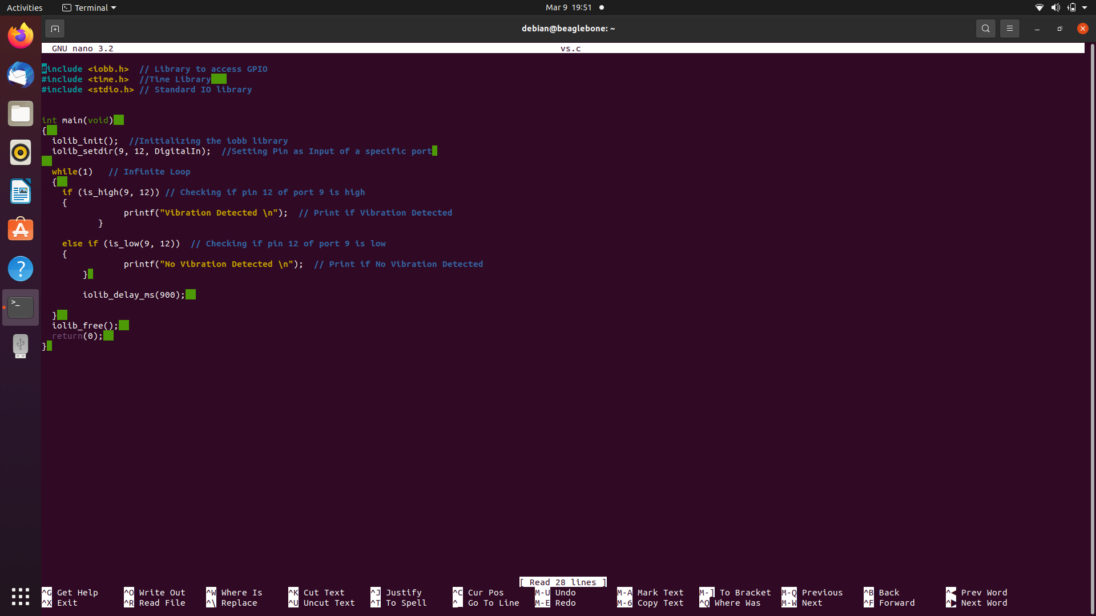
CODING OF VIBRATION SENSOR

Slide 20
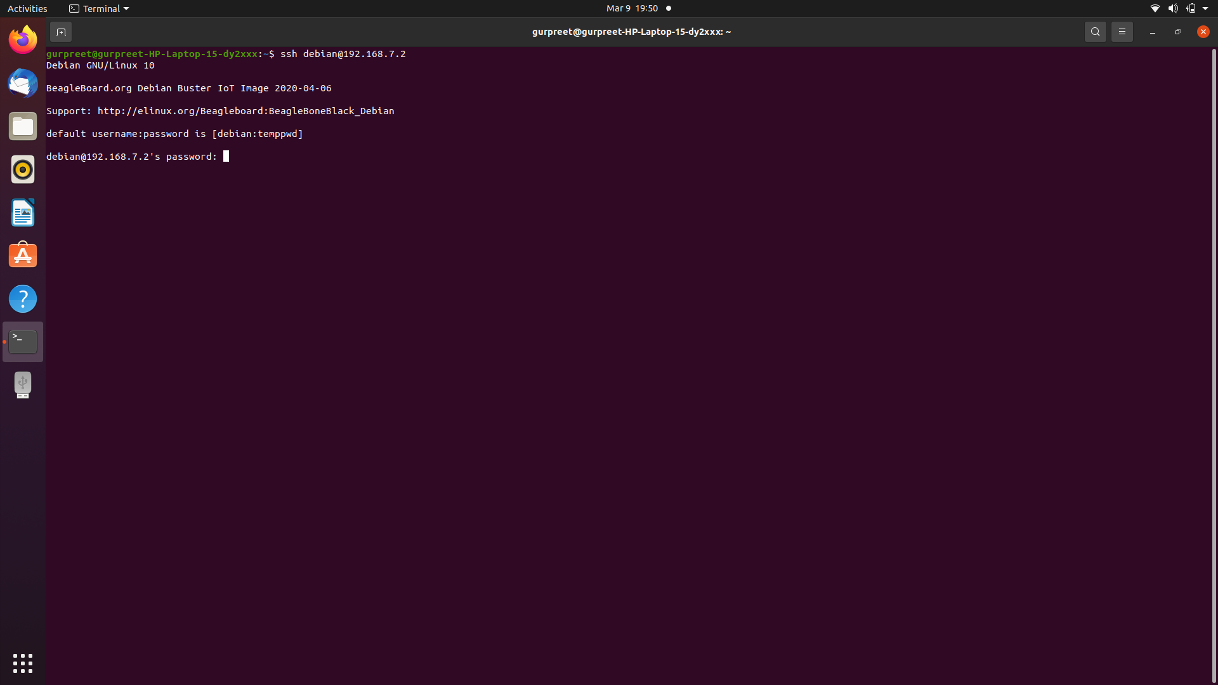
TERMINAL COMMANDS
STEP 1: Enter the command “ssh debian@192.168.7.2” here ssh command instruct the system to establish an encrypted secure connection with the host machine. Debian here represent the user_name that is being accessed on the host and then it is followed by an IP address.

Slide 21

TERMINAL COMMANDS
STEP2: Before continue to next step, the password “temppwd” must be entered.

Slide 22

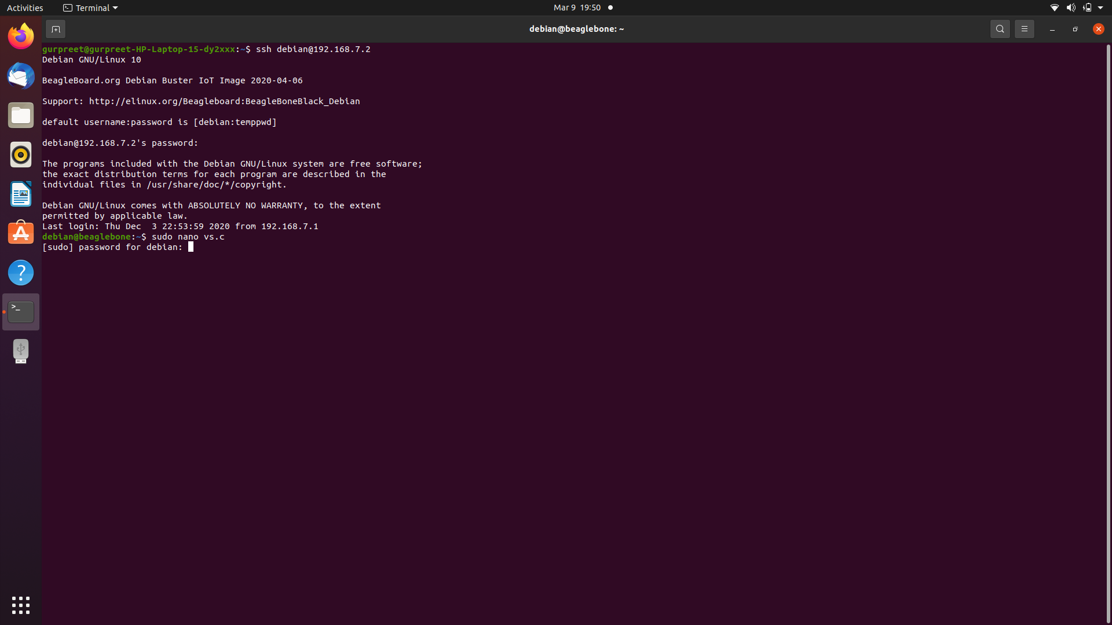
TERMINAL COMMANDS
STEP 3: Enter the command “sudo nano vs.c” to open Nano text editor and to directly write, edit and navigate the code and to get immediate onscreen feedback. Here, vs.c is the file name. Then enter the same password “temppwd.”
Here CTRL+O : save the code; then press enter; CTRL+X : to exit.

Slide 23
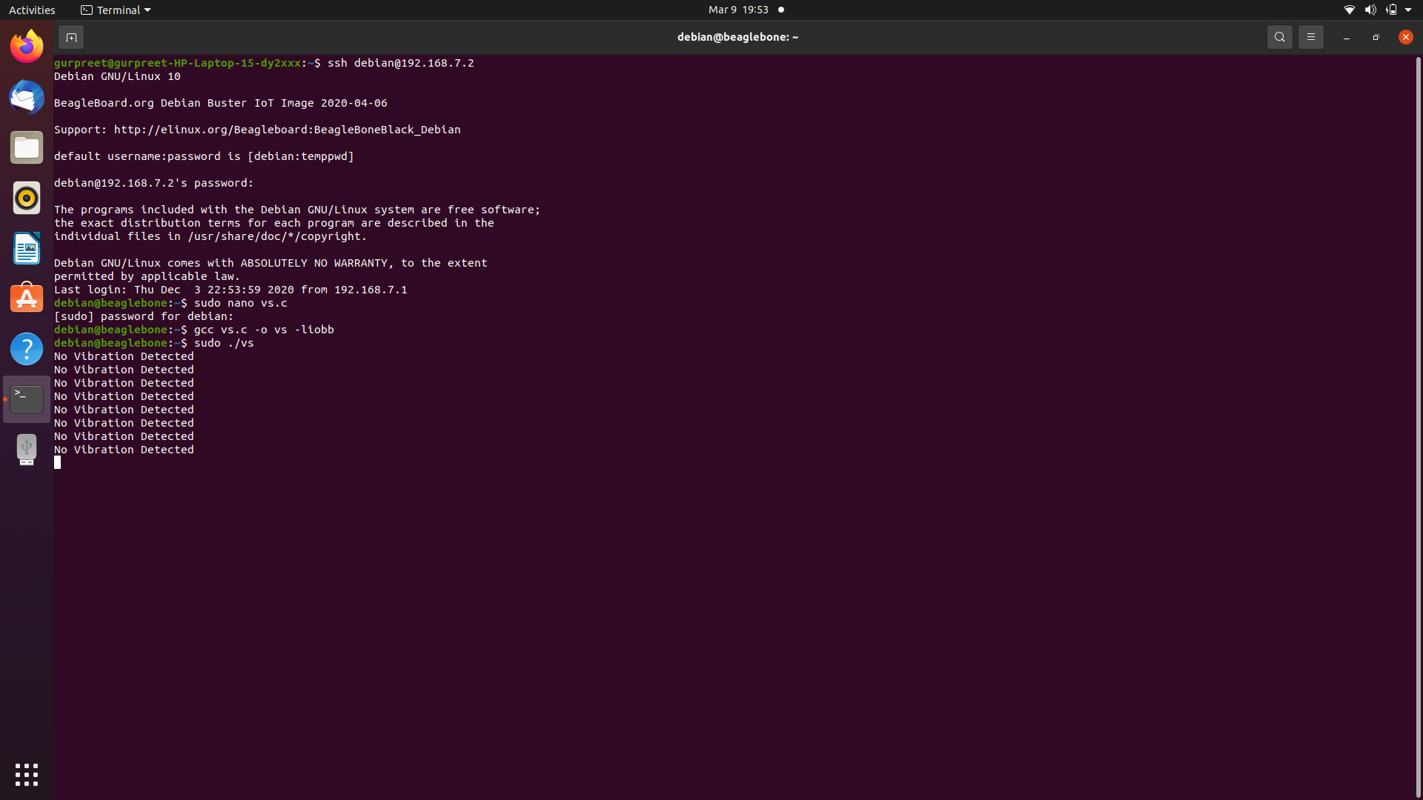
TERMINAL COMMANDS
For compilation and execution
STEP4: To compile and execute the code, enter the command “gcc vs.c -o vs liobb.” Here, vs.c is the program_name and vs is the executable file name. Afterwards, press Enter and write the Executable_name : “sudo ./vsTest.”
STEP5: Again enter the password: temppwd

Slide 24
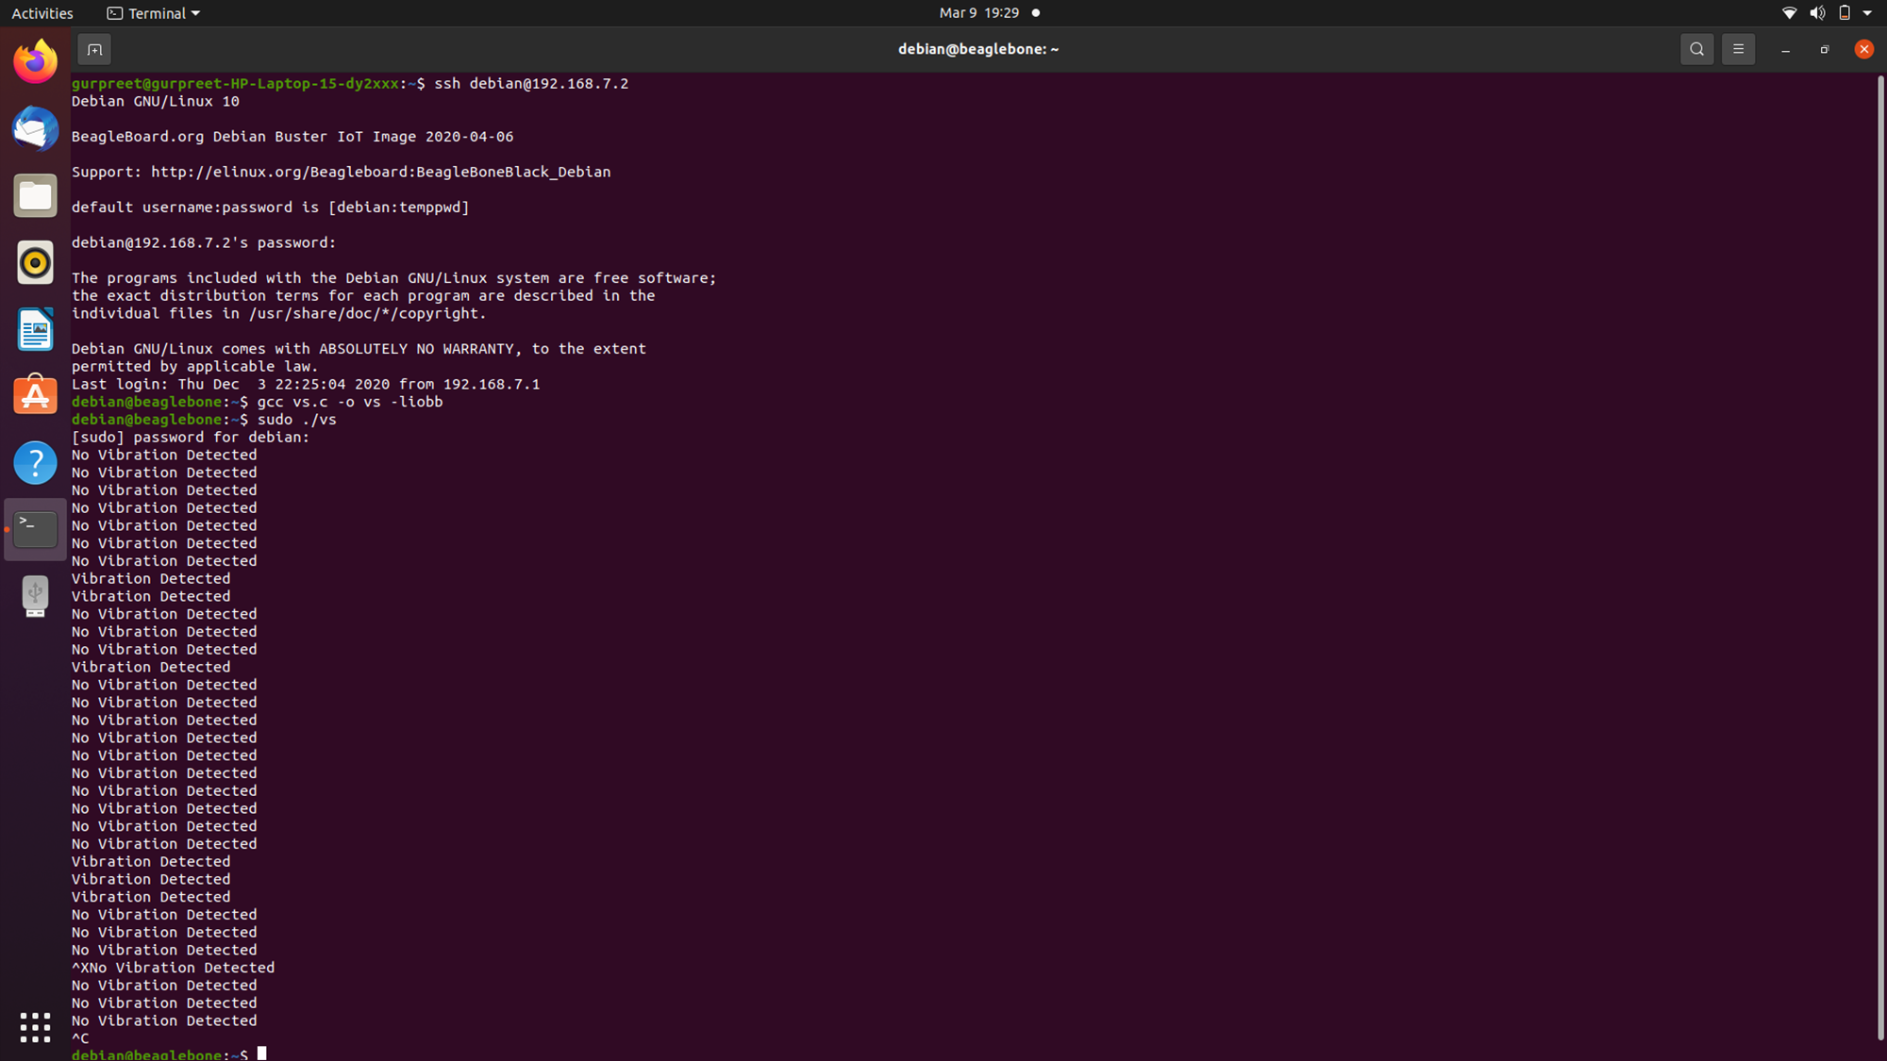
TERMINAL OUTPUT

Slide 25
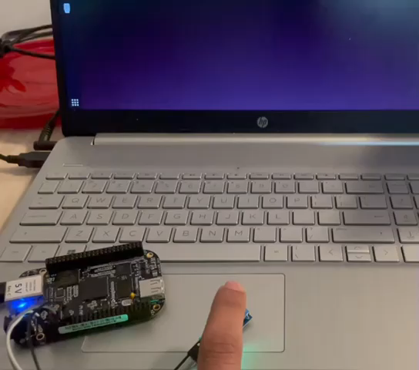
WORKING OF VIBRATION SENSOR

Slide 26
REFERENCES
Introduction of vibrator sensor: SW-420 Vibration Sensor Module Pinout, Datasheet, Features & Specifications (components101.com)
Vibration Sensor https://create.arduino.cc/projecthub/albertoz/vibration-sensor-module-c88067
Programming: (21) Interfacing Vibration Sensor Module with Arduino – YouTube
GPIO: BBB - BeagleBone Black I/O (GPIO) Library for C | element14 | BeagleBoard

Slide 27
THANK YOU

